Slide 1


Data Science Bootcamp
#1 rated Coding and Data Science Program in all of Orange County, Los Angeles, and the Inland Empire.
Prep Course Statistics

Slide 2



Statistics
Association:
In Statistics, association tells you whether two variables are related. The direction of the association is always symbolized by a sign either positive (+) or negative (-).
Source: https://analyse-it.com/docs/user-guide/multivariate/correlation
Notes:
Note: It is common to use the terms correlation and association interchangeably. Technically, association refers to any relationship between two variables, whereas correlation is often used to refer only to a linear relationship between two variables.

Slide 3
Association
Association between
Between two categorical variables
Between categorical and quantitative variables
Between two quantitative variable

Slide 4
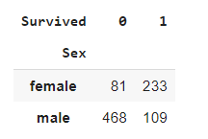
Association
summarize the observation from the two variables by looking at counts of the joint occurrence.
Titanic dataset

Slide 5
Association between two categorical variables
Proportion female survival p1 = 233/(81+233) = 0.74
Proportion male survival p2 = 109/(468+109) = 0.18
Difference in proportions p1 - p2 = 0.74 - 0.18 = 0.56
Relative risk p1/p2 = 0.74 / 0.18 = 4.1
Notes:
Odd’s ratio = p1/(1-p1) / p2/(1-p2)
= 2.846 / 0.219
= 12.995

Slide 6
Association between categorical and quantitative variables
Association can be summarized by looking at the distribution of the quantitative variable given the-- each value of the categorical variable.
And the distribution of a variable can be summarized using different statistics that we have discussed before, such as the mean, median.
Notes:
Odd’s ratio = p1/(1-p1) / p2/(1-p2)
= 2.846 / 0.219
= 12.995

Slide 7
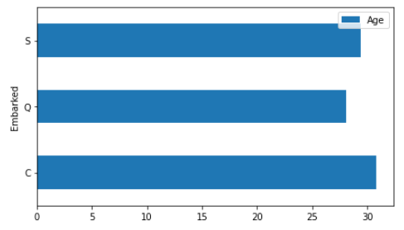
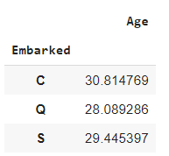
Association between categorical and quantitative variables
Notes:
We can measure the association by looking at the difference of the averages, or difference of the mean between categories, and to see
whether they have population difference indicating that, the port of embarkation, is associated with the value of a categorical variable,

Slide 8
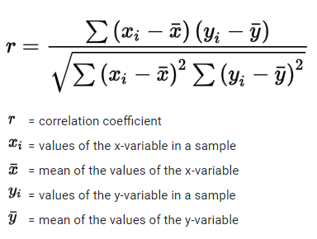
Association between quantitative variables
Statistic used to measure association between quantitative variables is called correlation. It is a single number of statistics for linear association. Correlation is a measure of linear association.
Notes:
Odd’s ratio = p1/(1-p1) / p2/(1-p2)
= 2.846 / 0.219
= 12.995

Slide 9
Correlation coefficient
r = Covariance(x,y) / S(x) * S(y)
1 is perfect positive correlation
-1 is perfect negative correlation
0 means no correletion

Slide 10
Association between quantitative variables
There's no distinction between x and y.
The value of correlation is always between -1 and 1
The value 0 indicating– indicates a weak linear association.
Correlation measures direction and strengths for linear relations.
Notes:
It is encouraged that we look at the scatterplot in addition to correlation to gauge the nature of the true association between x or y.

Slide 11
Exercise
Find association between Age as a categorical variable and survival
Find if there an association between Fare and survival rate
Correlation Coefficient

Slide 12
Statistics
Normal distribution, also known as the Gaussian distribution, is a probability distribution that is symmetric about the mean, showing that data near the mean are more frequent in occurrence than data far from the mean.
Source: www.investopedia.com › terms › normaldistribution
Notes:
The goal is to turn data into knowledge

Slide 13
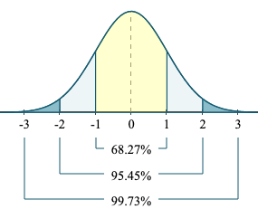
Normal distribution

Slide 14
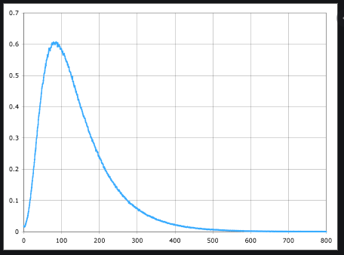
Key terms distribution
Tail The long narrow portion of a frequency distribution, where relatively extreme values occur at low frequency.

Slide 15
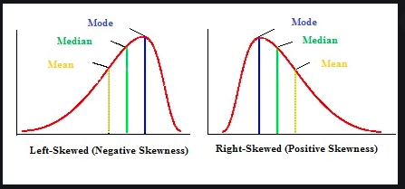
Key terms distribution
Skew Where one tail of a distribution is longer than the other.

Slide 16
Central limit theorem
The central limit theorem states that if you have a population with mean μ and standard deviation σ and take sufficiently large random samples from the population with replacement , then the distribution of the sample means will be approximately normally distributed.
Source : https://sphweb.bumc.bu.edu/otlt/MPH-Modules/BS/BS704_Probability/BS704_Probability12.html
Central limit theorem The tendency of the sampling distribution to take on a normal shape as sample size rises.

Slide 17
Other Distribution
Poisson distribution The frequency distribution of the number of events in sampled units of time or space.
Exponential distribution The frequency distribution of the time or distance from one event to the next event.
Weibull distribution A generalized version of the exponential, in which the event rate is allowed to shift over time.

Slide 18
Distribution and Statistic
Sample statistic A metric calculated for a sample of data drawn from a larger population.
Data distribution The frequency distribution of individual values in a data set.
Sampling distribution The frequency distribution of a sample statistic over many samples or resamples.

Slide 19
Central limit theorem
Means drawn from multiple samples will resemble the familiar bell-shaped normal curve (see “Normal Distribution”), even if the source population is not normally distributed, provided that the sample size is large enough.

Slide 20
Type of Probability
Independent events
Probability of an event happening = # ways it can happen/Total # of outcomes
5 balls in a bag: 4 are blue, and 1 is red - probability of picking blue ball
Conditional probability
5 balls in a bag: 4 are blue, and 1 is red - probability of picking blue ball when the first ball picked is blue

Slide 21
Law of probabilities
Assign the participants into two groups
Treatment group
Controlled group
Participants have demographic background, and their individual profiles. age, for height, for weight,
If there is a difference in results, can this different be purely explained by chance?
using statistical method establishes the statistical significance of observed signal by studying randomness

Slide 22
Uncertainty/ Probability
Probability deals with predicting the likelihood of future events
Mathematician approach
Statistician approach

Slide 23
Parameter and Statistic
A parameter is a value that describes a characteristic of an entire population, such as the population mean. Because you can almost never measure an entire population, you usually don’t know the real value of a parameter. In fact, parameter values are nearly always unknowable. While we don’t know the value, it definitely exists.
The population mean and standard deviation are two common parameters. In statistics, Greek symbols usually represent population parameters, such as μ (mu) for the mean and σ (sigma) for the standard deviation.
A statistic is a characteristic of a sample. If you collect a sample and calculate the mean and standard deviation, these are sample statistics. Inferential statistics allow you to use sample statistics to make conclusions about a population. However, to draw valid conclusions, you must use particular sampling techniques. These techniques help ensure that samples produce unbiased estimates.
In inferential statistics, we use sample statistics to estimate population parameters. For example, if we collect a random sample of adult women in the United States and measure their heights, we can calculate the sample mean and use it as an unbiased estimate of the population mean. We can also perform hypothesis testing on the sample estimate and create confidence intervals to construct a range that the actual population value likely falls within.

Slide 24
Central limit theorem
Standard error can be estimated using a statistic based on the standard deviation s of the sample values, and the sample size n.
samples (not to be confused with standard deviation, which, by itself, refers to variability of individual data values).
SE = s/(n)^1/2

Slide 25
Key terms
Error The difference between a data point and a predicted or average value.
Standardize Subtract the mean and divide by the standard deviation.
z-score The result of standardizing an individual data point.
Standard normal A normal distribution with mean = 0 and standard deviation = 1
Tail The long narrow portion of a frequency distribution, where relatively extreme values occur at low frequency.
Skew Where one tail of a distribution is longer than the other.

Slide 26
SCALING DATA
Variables measured on different scales need to be transformed to similar scales, so that their impact on algorithms is not determined mainly by their scale.
A common scaling method is normalization (standardization)— subtracting the mean and dividing by the standard deviation.
Another method is Gower’s distance, which scales all variables to the 0–1 range (it is often used with mixed numeric and categorical data).
Scaling Squashing or expanding data, usually to bring multiple variables to the same scale.
Normalization One method of scaling—subtracting the mean and dividing by the standard deviation. Synonym Standardization
Gower’s distance A scaling algorithm applied to mixed numeric and categorical data to bring all variables to a 0–1 range.

Slide 27
DATA SCIENCE ADDITIONAL READINGS
ASA Whitepaper: Discovery with Data: Leveraging Statistics with Computer Science to Transform Science and Society. http://www.amstat.org/policy/pdfs/BigDataStatisticsJune2014.pdf
A Cartoon Guide to Statistics http://www.amazon.com/Cartoon-Guide-Statistics-Larry-Gonick/dp/0062731025
Naked Statistics http://www.amazon.com/Naked-Statistics-Stripping-Dread-Data/dp/1480590185

Slide 28
Exercise
What is target market? Male or female
Who is our target age to Maximize profit
What product should we feature
Product type to feature in our marketing
What lead sources have worked in the past website, flyer or emails
When is the best time to do email marketing

